Slide 1

Progress Towards Decentralization and Integration of HCV Services in Primary Care, Hospitals and Harm Reduction Settings in Georgia
Dr. David Sergeenko,
Minister of Labour, Health and Social Affairs of Georgia

Slide 2

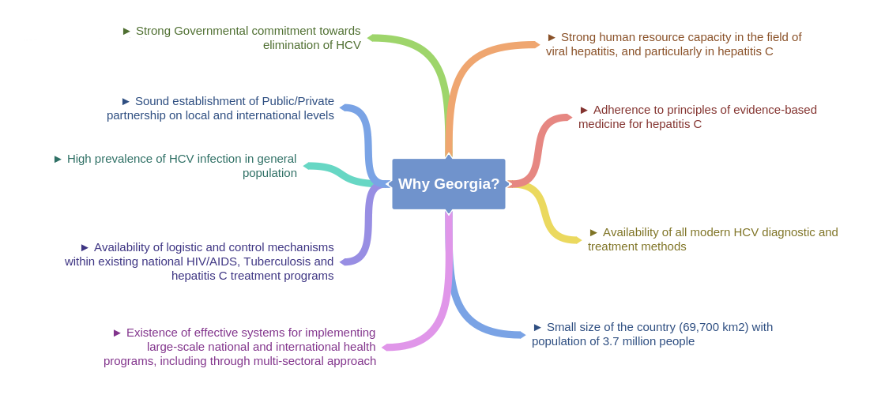
Georgia
The country of Georgia has high burden of hepatitis C virus (HCV) infection. The nationwide seroprevalence survey conducted in 2015, indicated 5.4% of adults (approximately 150,000 persons) with active HCV infection (RNA positive).
Characteristic | n | % | Estimated # nationwide ≥18 years
Anti-HCV+ | 433 | 7.7% | 215,000
HCV RNA+ | 311 | 5.4% | 150,000

Slide 3


Targets
Goal
Elimination of HCV by ensuring prevention, diagnostics and treatment of the disease
90-95-95
By 2020
90% of people living with HCV are diagnosed
95% of those diagnosed are treated
95% of those treated are cured
Approved on August 18, 2016
National Center for Disease Control and Public Health
www.NCDC.ge

Slide 4

Progress Towards Strategic Objectives
Enhancement of screening
through extending it to the
more than 600 centers countrywide,
including inpatient and outpatient
settings, pharmacies, Public Health
Centers, Harm Reduction Cites, etc.
Massive awareness raising campaigns
32 medical facilities providing
treatment services countrywide
Short text messages (SMS)
regularly sent to the population
to invite them to the HCV screening
Promote advocacy, awareness and
education, and partnerships for HCV associated resource mobilization
Identify Persons Infected with HCV
Overall SVR rate – 98%
Provide HCV Care and Treatment
Development of unified
electronic screening module
that combines screening data
from all sources
HCV Hotline established
Identification and Characterization of
HCV-Attributable Hepatocellular
Carcinoma – in collaboration
with US CDC
Infection control and prevention
monitoring and evaluation in
medical and non-medical
facilities
Research activities for the simplification
of HCV diagnostics, including studies
on HCV cAg and various PCR
approaches
Survey to find the barriers and facilitators
to enroll in the HCV treatment
program supported by
US CDC and LIFER
Regular screening activities
among PWID and their
sexual partners
Improve HCV Laboratory Diagnostics
Improve HCV Surveillance
Prevent HCV transmission
Introduction of external quality
assessment in NCDC referral
laboratory (Lugar Center)
Improved quality control
mechanisms for
blood banks
HCV seroprevalence survey
to be repeated in 2019

Slide 5


Road Towards HCV Elimination
Patient inclusion criteria removed
Long-term Elimination
Strategy 2016-2020 approved
2016
2018
Geographic and financial access to
diagnostic services - significantly increased
LDV/SOF based regimens
introduced to the program
Decentralization of HCV services
TAG established
2nd World Hepatitis Summit
World Hepatitis Summit
Enhancement of electronic information systems
Memorandum of Understanding between Georgian Government and Gilead Sciences
HCV Screening Protocol approved by the Ministry
2015
2017
Initial phase of HCV elimination action plan
TAG recommendation on decentralization
Notes:
Considering achievements and challenges each year sets specific priorities on the road towards the elimination of HCV in Georgia. In 2015 we launched the elimination program with broad objectives and priorities, , in 2016 the government approved HCV strategy, in 2017 we put emphasis on HCV screening and detection and developing supporting systems; with technical partners and colleagues we have defined Decentralization as a priority for 2018 for acceleration of patients enrolment in treatment

Slide 6
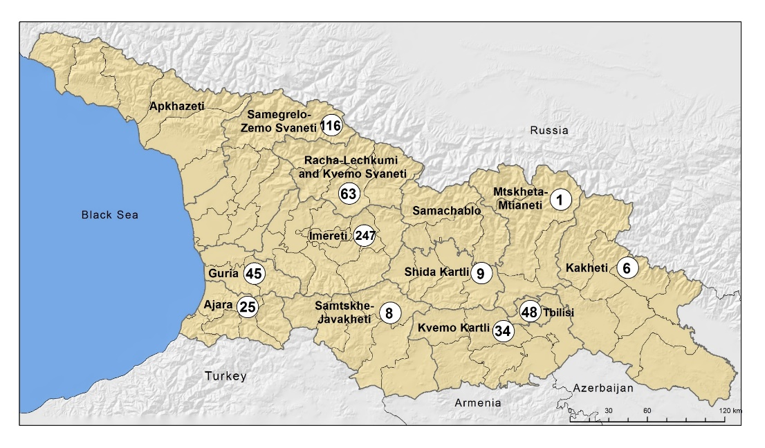
HCV Screening Among Different Target Groups
602 outpatient facilities providing screening
Since 2015, ~1,6 million persons have been screened
among which more than 1 million were unique individuals with positivity rate 10.3%

Slide 7
April 28, 2015 – February 28, 2018
Georgia Hepatitis C Elimination Program Care Cascade
* Of 37,500 patients eligible for SVR assessment, 28,806 were tested, 28,283 (98.2%) achieved SVR, 8,694 (23.2%) missing data

Slide 8
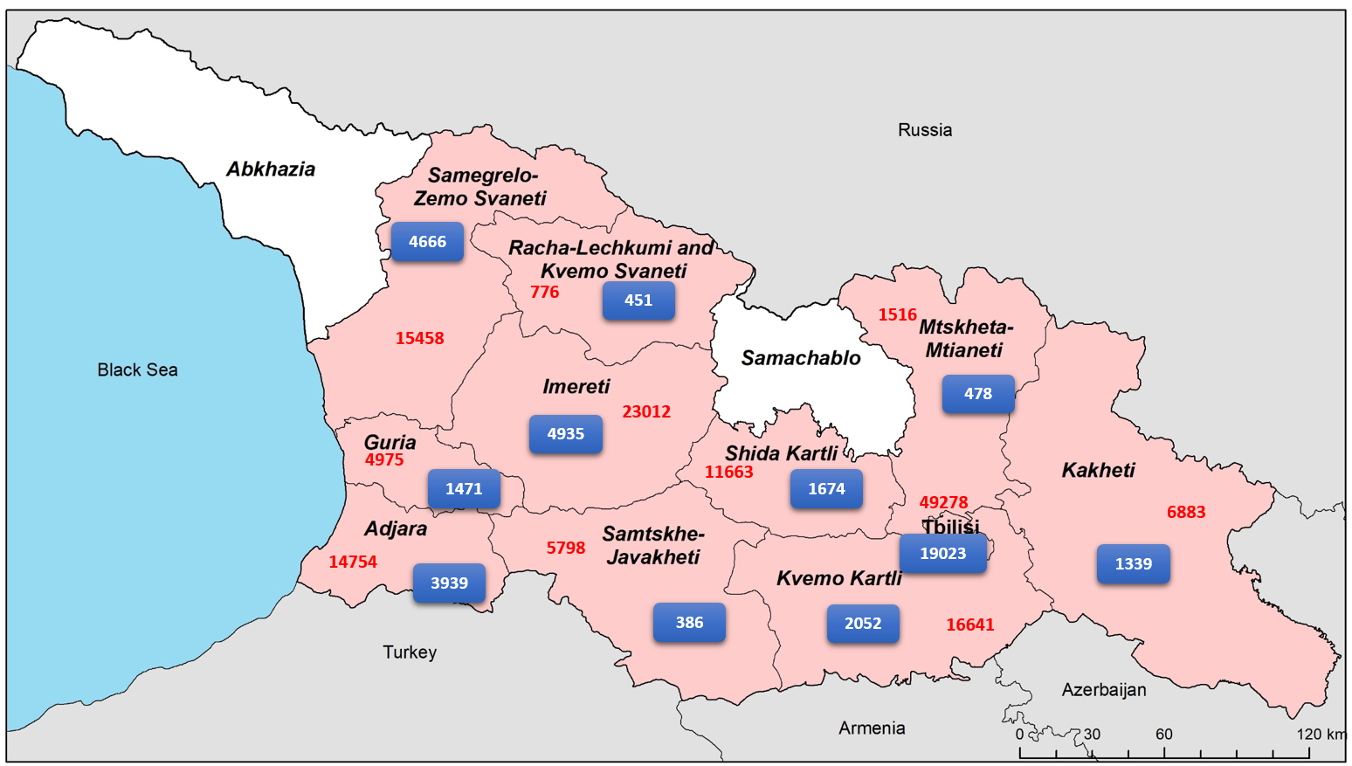
Treatment Coverage per Region
Overall coverage rate date ~ 30%
Enrolled in Treatment
Target Population
Notes:
Coverage: since launching of the program up to 30% of estimated number of patients ()based on sero -prevalence survey enrolled in treatment with grates coverage of high burden regions namely : 40% coverage in Tbilisi, 30% coverage in Samegrelo and 27% coverage in Ajara regions.

Slide 9
Enrollment in the HCV treatment program
Decentralization
SOF introduced
LDV/SOF introduced
Notes:
9. Regardless of 30% treatment coverage achieved in 30 months of the elimination program we have observed declined trend of patients' enrolment in treatment during last few months; the trend might be explained by enrolment of symptomatic patients in treatment at the early stage of the program; based on TAG recommendations and treatment roll out modeling exercise we know that to achieve elimination goal the number of patients to be enrolled in treatment should be 2-2,500 per month;, we have to increase treatment uptake by bringing services closer to the patients therefore priority for this year is decentralization of HCV diagnostic and treatment services

Slide 10
Objectives of Decentralization
Increase geographical accessibility
Increase financial accessibility
decentralization of screening, care and treatment services
simplified diagnostics algorithms
Minimize cost of diagnostics
Notes:
Decentralization offers not only improved geographic access but provides opportunities for building costs effective model of care. The concept is in line with WHO Global health sector strategy on viral hepatitis 2016-2021 and São Paulo Declaration on Hepatitis which calls for introducing new models of people-centered integrated service delivery

Slide 11
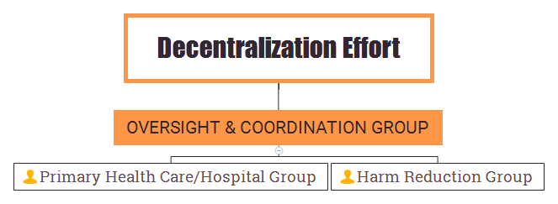
Decentralization Concept
Working Groups Established
Action Plan for Decentralization
Launch of program by June 2018
Progress report for TAG 2018
Notes:
For implementation of the Decentralization concept initial steps have been taken: oversight and coordination group with two subgroups established with goal to develop and launch the decentralization program by June 2018

Slide 12
Progress towards decentralization
HCV screening widely accessible at all levels (including at community level)
Point of care RNA confirmatory testing is available
Simplified diagnostic and treatment protocols developed for general health settings and harm reduction centers
CME training program for PHC physicians developed and approved
Training for PHC and Hospital staff has been launched
ECHO platform is utilized for training and care decentralization support
HCV elimination program database is modified in response to HCV care decentralization needs
Notes:
Initial steps for decentralization have been undertaken: (as listed in the slide)
Slide 13 a. Action Plan for Decentralization, which will be launched in June 2018, will include all necessary interventions for making HCV service available at all districts. If in 2015 there were only 4 specialized service providers, the number was increased to 31 in 2017 and which decentralization we will have about 70 service providers countrywide that will help to minimize geographic barriers to aces the needed care

Slide 13

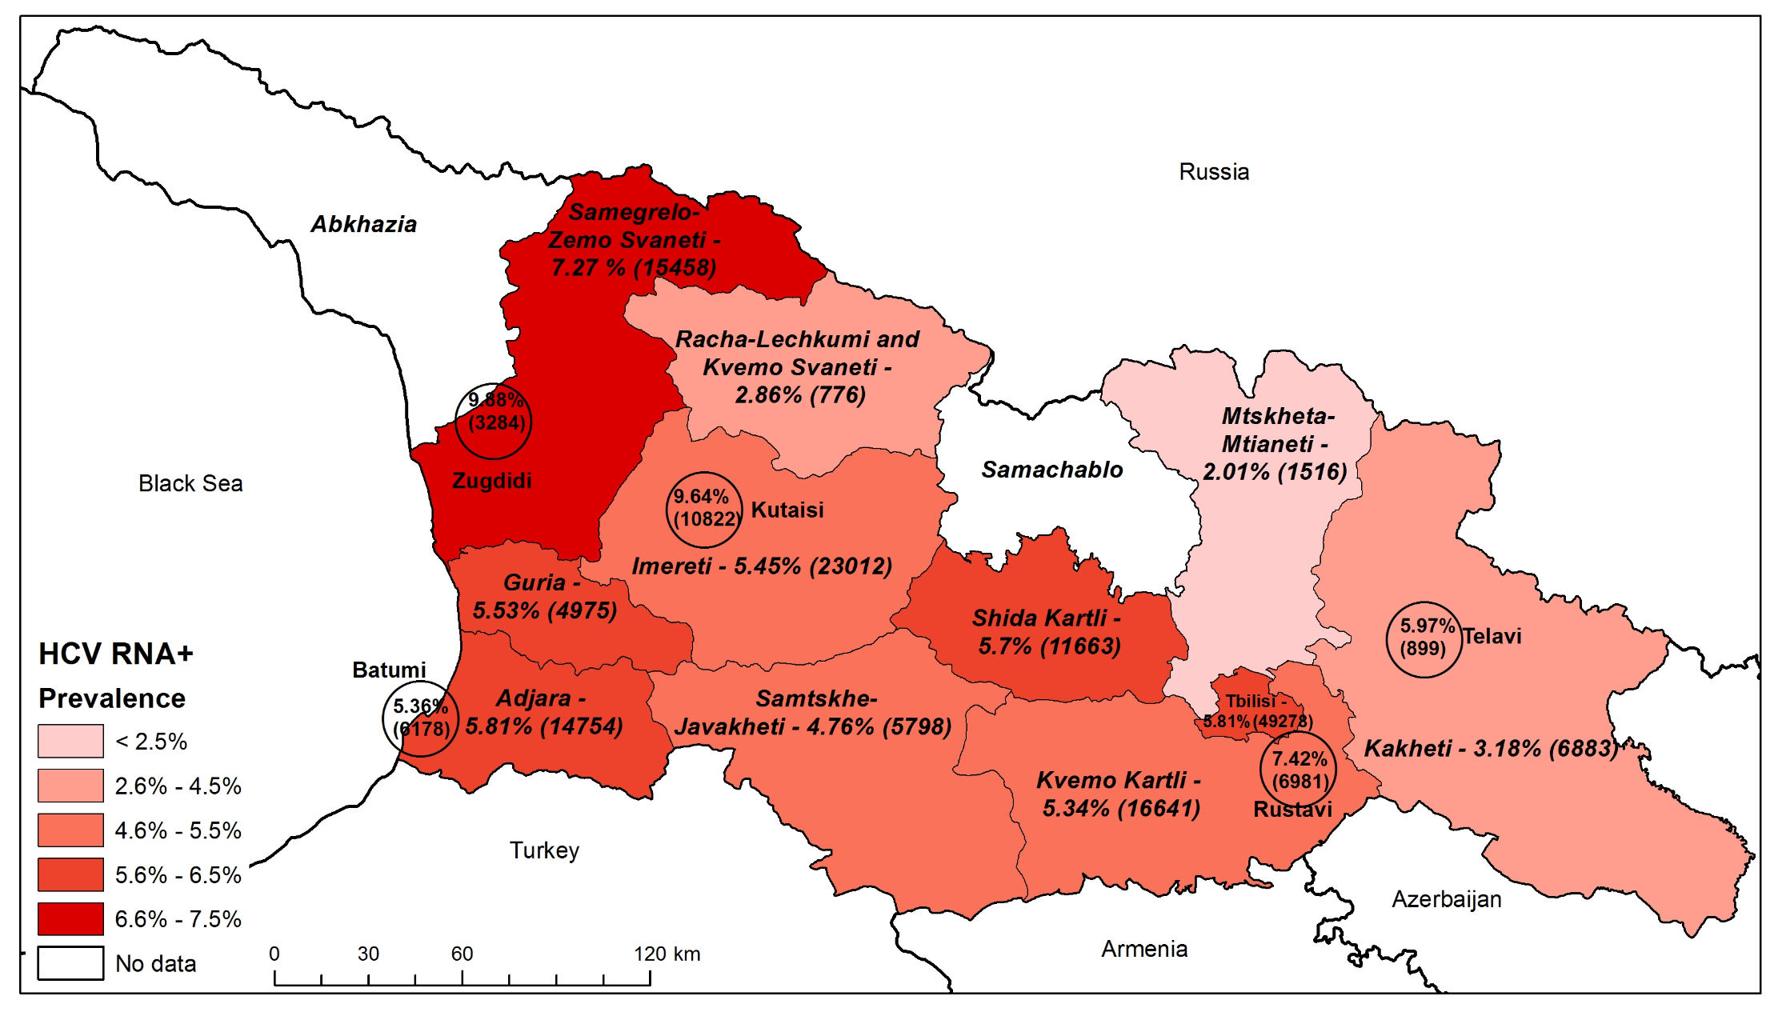
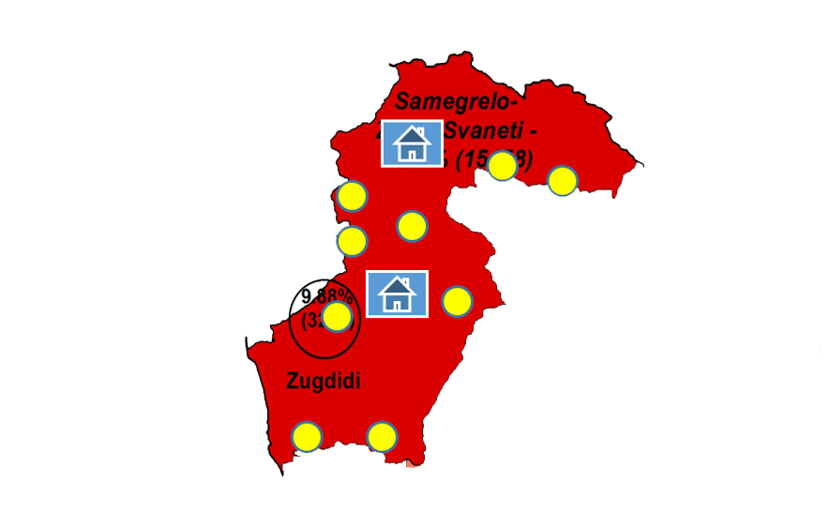
HCV Prevalence – 7,27% (HCV RNA+)
Estimated number of HCV RNA+ 15,458
TB Prevalence - 113 (100,000 population)
Number of notified cases – 373
HIV/AIDS Prevalence – 208 (100,000 population)
Number of cases - 868
Decentralization Concept (Regions)
Pilot project in Samegrelo-Zemo Svaneti Region was lunched in November, 2017
Service Provider
Decentralization of integrated screening and detection of TB/HIV/HCV at primary health care settings
Implementation
progress
New HCV Centers
Integrated TB/HIC/HCV screening protocol approved
454 doctors and nurses trained
Integrated service monitoring multidisciplinary groups established
Municipal programs supporting pilot implementation approved
Up to 70 Sites
After Decentralization
31 sites by October, 2017
4 Sites (launch of the program in April 2015)
Target for HCV testing
40% coverage of local population by November, 2018
Notes:
Universal coverage of all three diseases, high political commitment to Hep C Elimination program and available resources to support new models of care delivery under the global fund program gave us an opportunity to develop and launch Pilot project in Samegrelo region with aim to decentralize and integrate screening and detection of TB/HIV/HCV at primary health care level in the region. Pilot region was selected based on significant burden of TB, HIV, HCV
in Samegrelo Zemo Svaneti. Program was launched in last November with support of local government. Up to date, Integrated TB/HIC/HCV screening protocol developed and approved; 454 doctors and nurses trained; integrated service monitoring multidisciplinary groups established in all districts; Municipal programs, with relevant budgets supporting pilot implementation approved. Testing in PHC setting including in villages was started from 2 April will reach 40% HCV detection by November 2018. The concept will be expanded to Adjara region as soon as first results of Samegrelo pilot will be available

Slide 14
Pilot Projects
“Integrating HCV screening and simplified treatment services in primary healthcare” – project of the Infectious Diseases, AIDS and Clinical Immunology Research Center, which aims to eliminate barriers and improve engagement in the entire continuum of HCV care;
,,Simplifying pre-treatment diagnostic tests and treatment monitoring process in the Hepatitis C Elimination Project” - Project of Clinics “Mrcheveli” and “NeoLab”
FIND’s Head Start Project, which aims to scale up effective diagnosis and linkage to care of PWIDs through harm reduction sites.

Slide 15
Conclusion
In the first 30 months of the HCV Elimination Program, Georgia has scaled up the screening and treatment services achieving impressive results- 30% treatment coverage with 98% cure rate
Enhancing HCV testing and linkage to care and treatment services are critical to reaching the 2020 HCV elimination goal
Provision of HCV screening, confirmation, care and treatment services at non-specialized settings nearer to patients’ homes is critical for achieving HCV elimination goals
Decentralization and integration of HCV services delivery in primary care or harm reduction settings can result in overcoming barriers to access for HCV care and treatment
HCV Elimination program is major driver for Health System Strengthening and advancing Public Health Agenda
Lessons learned from the Georgia elimination program can inform programs in other countries striving to eliminate HCV as a public health threat.

Slide 16








Acknowledgements
US Centers for Disease Control and Prevention (CDC)
Gilead Sciences, Inc.
WHO, WHO Euro
TAG Members
LIFER
ECHO
World Hepatitis Alliance
Nohep Movement
Ministry of Labour, Health and Social Affairs
National Center for Disease Control and Public Health

